Slide 1
Communication System IICT Lecture 10

Slide 2
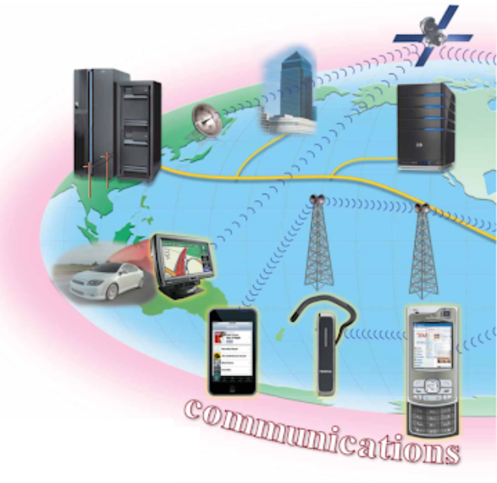
What is Communication?
Computer communications describes a process in which two or more computers/devices transfer data, instructions, and information.
Some communications involve cables and wires; others are sent wirelessly through the air.
Figure shows a sample communications system.
Notes:
Act of transferring information from one place to another

Slide 3
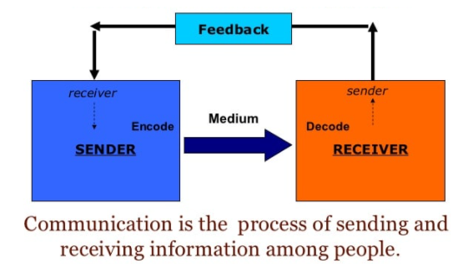
Communications systems contain all types of computers and computing devices. For successful communications, you need:
Sending device: initiates an instruction to transmit data, instructions, or information.
Communication device: connects the sending device to a communications channel.
Communication channel: or transmission media on which the data, instructions, or information travel.
Communication device that connects the communications channel to a receiving device.
Receiving device that accepts the transmission of data, instructions, or information.

Slide 4
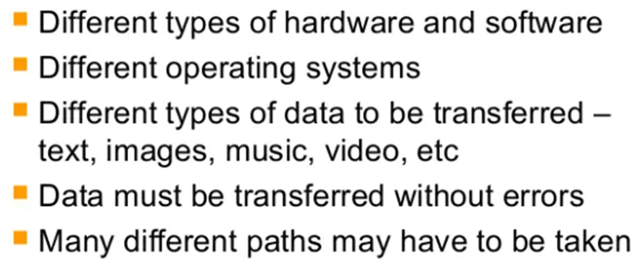
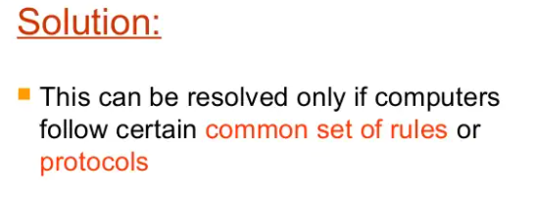
Network Complexities

Slide 5
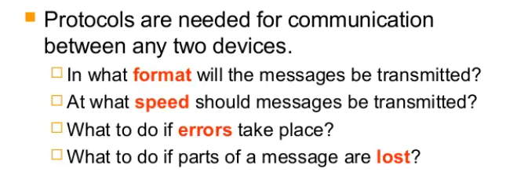
What is a Protocol?

Slide 6
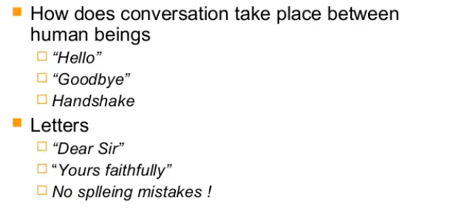
Protocols in Daily Life

Slide 7
Communication Protocol
A communication protocol is a system of rules that allows two or more entities of a communications system to transmit information via any kind of variation of a physical quantity.
The protocol defines the rules, syntax, semantics and synchronization of communication and possible error recovery methods.
Hence, a protocol is a set of rules which governs the transfer of data between computers.
Protocols allow communication between computers and networks.

Slide 8
Characteristics of Communication System
There must be a Sender and Receiver
Handshaking is used to establish which protocols to use. Handshaking controls the flow of data between computers
Protocols will determine the speed of transmission, error checking method, size of bytes, and whether synchronous or asynchronous.

Slide 9
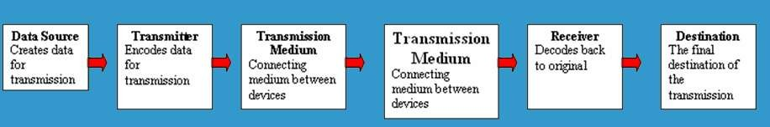
Five Basic Components
Every communication system has 5 basic requirements
Data Source (where the data originates)
Transmitter (device used to transmit data)
Transmission Medium (cables or non cable)
Receiver (device used to receive data)
Destination (where the data will be placed)

Slide 10
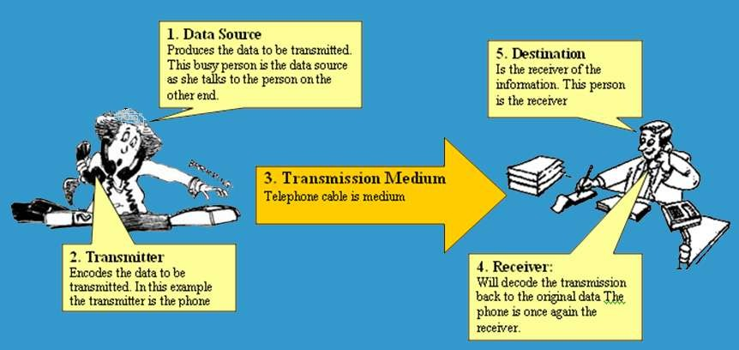
Pictorial Representation

Slide 11
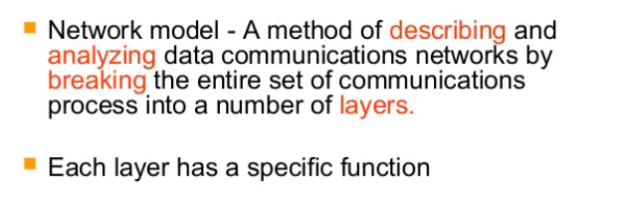
Network Model

Slide 12
OSI Model
The Open Systems Interconnection model (OSI model) is a conceptual model that characterizes and standardizes the communication functions of a telecommunication or computing system without regard to its underlying internal structure and technology.
The OSI model also provides much more information which is included with each package.

Slide 13
7 Layers of OSI Model
OSI “Open System Interconnection”
OSI is not a protocol but a list of protocols divided between 7 layers with each layer having a different set of functions.
Each packet is layered/packaged with protocols from each of the layers as it is processed.
The process of layering the protocols around each package is called encapsulation. The final encapsulated data packet is called a frame.

Slide 14
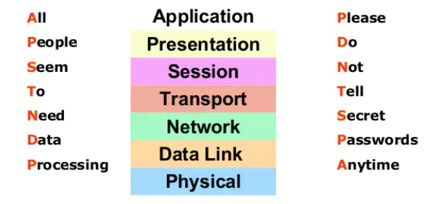
Layers of OSI Model
Some Mnemonics

Slide 15
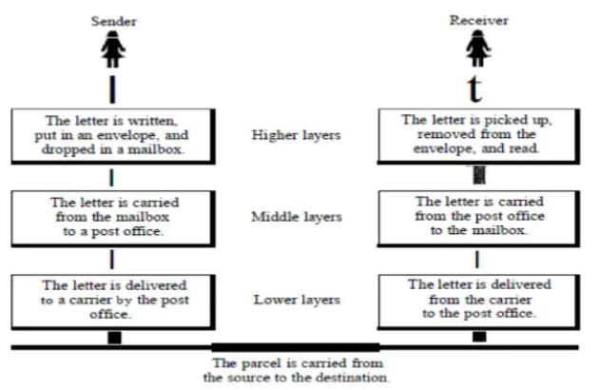

Slide 16
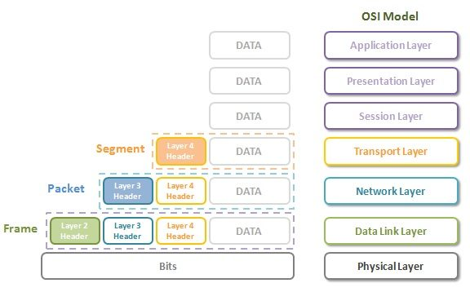
OSI Model

Slide 17
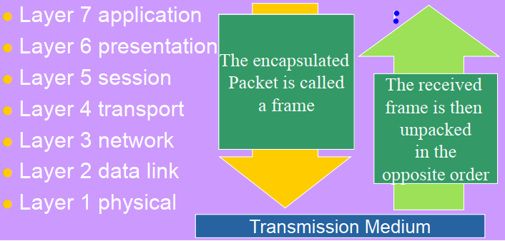
OSI Model
OSI Reference Model

Slide 18
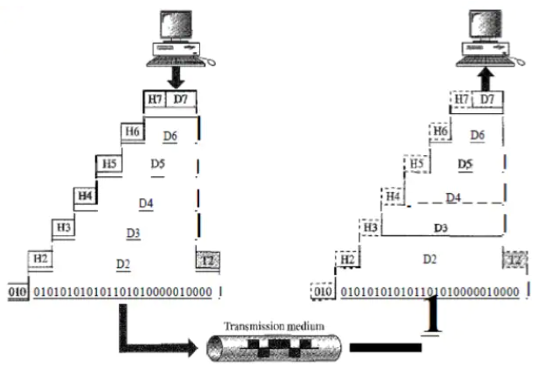
Sender
Receiver

Slide 19
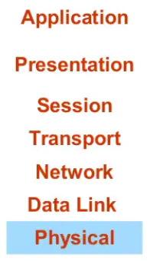
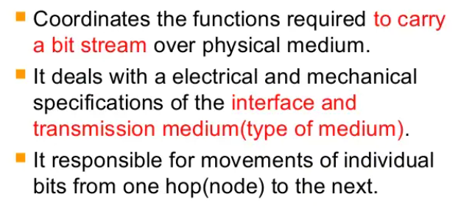
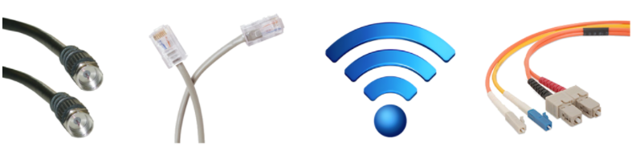
Physical Layer

Slide 20
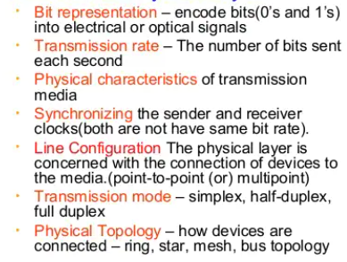
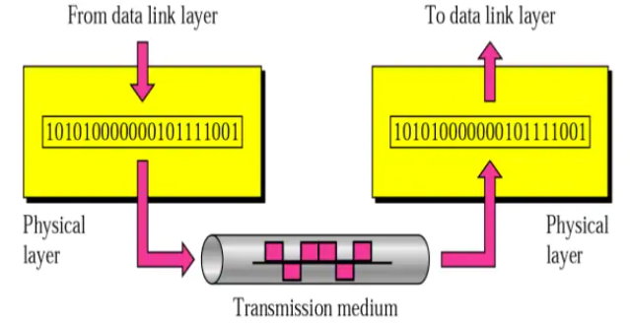

Functions of Physical Layer:

Slide 21
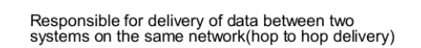
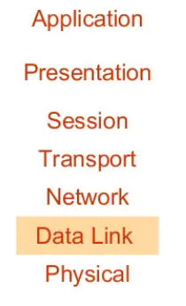
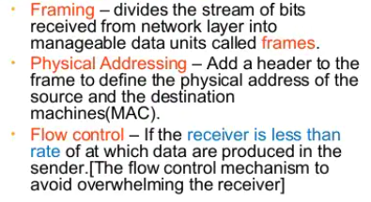
Data Link Layer
The Network Interface Card (NIC) that you plug your Ethernet wire into handles the Layer 2 functionality.
It receives signals from the wire, and transmits signals on to the wire.
Your Wi-Fi NIC works the same way, receiving and transmitting
radio waves which are then interpreted as a series of 1’s and
0’s.
Functions of Data Link Layer:

Slide 22
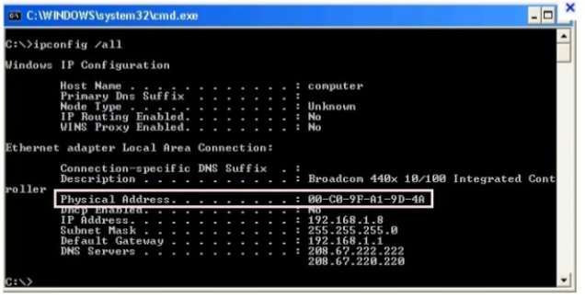
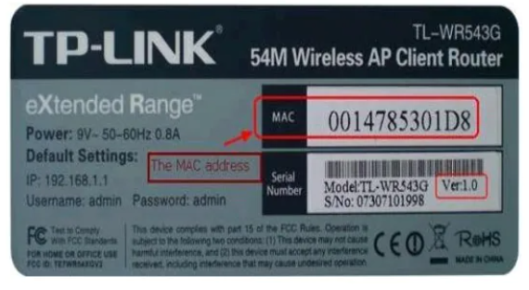
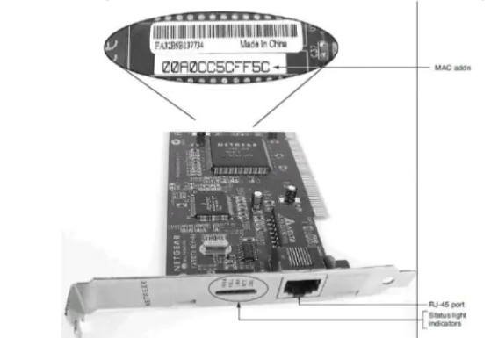
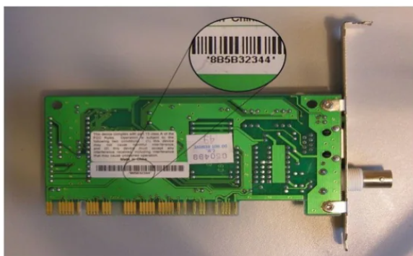
MAC (Medium Access Control)

Slide 23
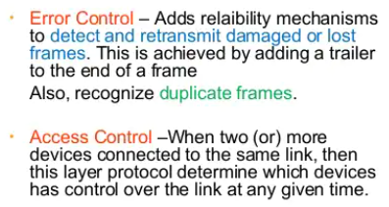
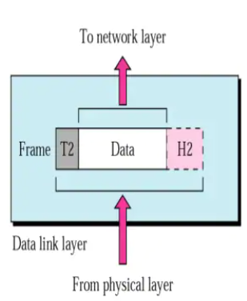



Slide 24
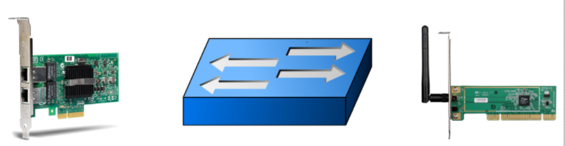
This Layer will group together those 1’s and 0’s into chunks known as Frames.

Slide 25
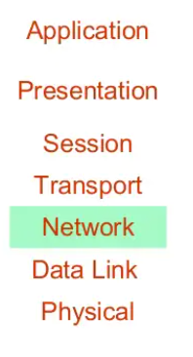
Network Layer
The Network layer of the OSI model is responsible for packet delivery from end to end.
It does this by using another addressing scheme that can logically identify every node connected to the Internet. This addressing scheme is known as the Internet Protocol address, or the IP Address.
It is considered logical because an IP address is not a permanent identification of a computer unlike the MAC address

Slide 26
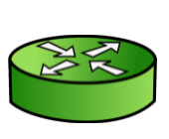
Functions of Network Layer:
Routers are Network Devices that operate at Layer 3 of the OSI model. A Router’s primary responsibility is to facilitate communication between Networks. As such, a Router creates a boundary between two networks. In order to communicate with any device not directly in your network, a router must be used.

Slide 27
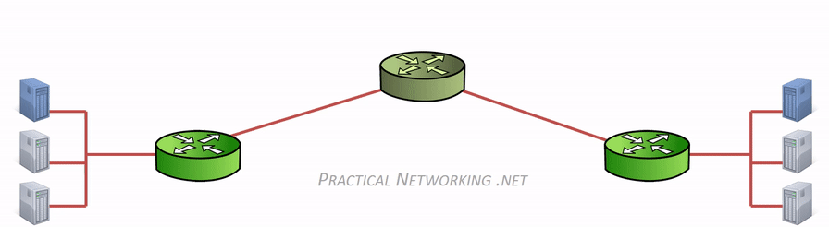
OSI Model – Layer 2 vs. Layer 3
The interaction and distinction between Layer 2 and Layer 3 is crucial to understanding how data flows between two computers.
For example, if we already have a unique L2 addressing scheme on every NIC (like MAC addresses), why do we need yet another addressing scheme at L3 (like IP addresses)? Or vice versa?
The answer is: Both addressing schemes accomplish different functions:
Layer 2 uses MAC addresses & is responsible for packet delivery from hop to hop.
Layer 3 uses IP addresses & is responsible for packet delivery from end to end.
When a computer has data to send, it encapsulates it in a IP header which will include information like the Source and Destination IP addresses of the two “ends” of the communication.
The IP Header and Data are then further encapsulated in a MAC address header, which will include information like the Source and Destination MAC address of the current “hop” in the path towards the final destination.
Notice between each Router, the MAC address header is stripped and regenerated to get it to the next hop. The IP header generated by the first computer is only stripped off by the final computer, hence the IP header handled the “end to end” delivery, and each of the four different MAC headers involved in this animation handled the “hop to hop” delivery.

Slide 28
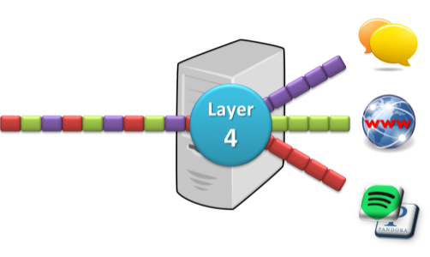
Transport Layer
The Transport layer of the OSI model is responsible for distinguishing network streams.
Example:
At any given time, a user’s computer have opened an Internet browser, while music is being streamed, while a messenger or chat app is running.
Each of these applications are sending and receiving data from the Internet, and all that data is arriving in the form of 1’s and 0’s on to that computer’s NIC.
Something has to exist in order to distinguish which 1’s and 0’s belong to the messenger or the browser or the streaming music. That “something” is Layer 4
Specifically, two methods of distinguishing network streams exist. They are known as the Transmission Control Protocol (TCP), or the User Datagram Protocol (UDP).
Both TCP and UDP have 65,536 port numbers (each), and a unique application stream is identified by both a Source and Destination port (in combination with their Source and Destination IP address).
This Layer is responsible for service to service delivery

Slide 29
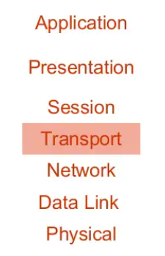
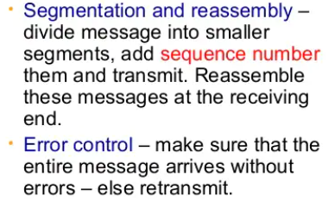
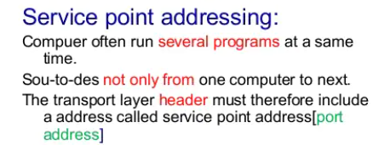
Transport Layer
Responsible for source- to-destination delivery of the entire message
Functions of Transport Layer:

Slide 30
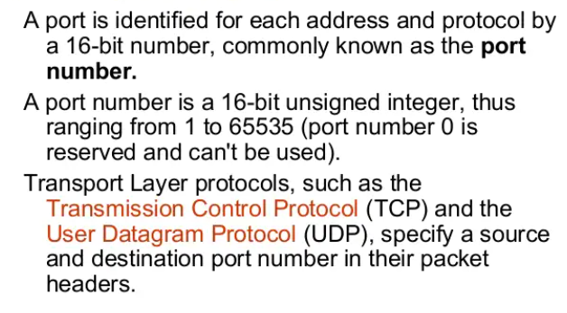
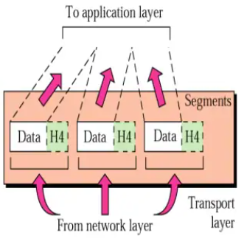
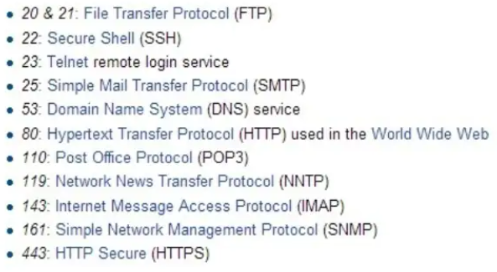
Layer 4 accomplishes task by using an addressing scheme known as Port Numbers.

Slide 31
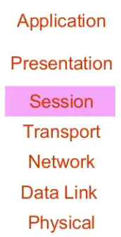
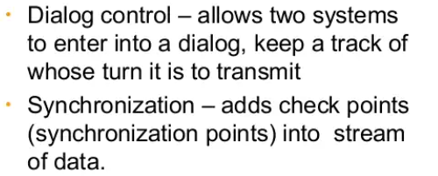
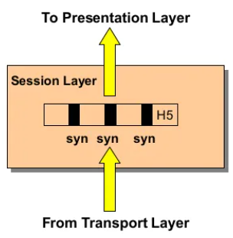
Session Layer
It defines how to start, control and end conversations (called sessions) between applications
Functions of Session Layer:
Session closure

Slide 32
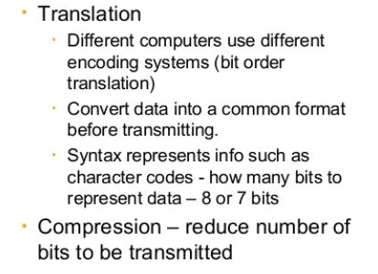
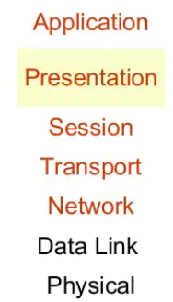
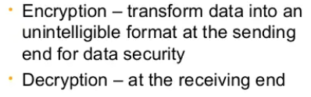
Presentation Layer
It defines the format in which the data is to be exchanged b/w two communication entities
Functions of Presentation Layer:

Slide 33
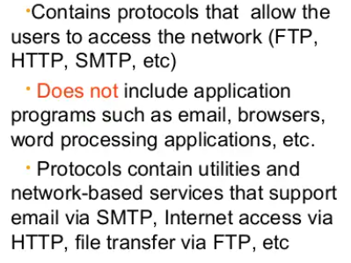
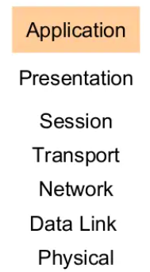
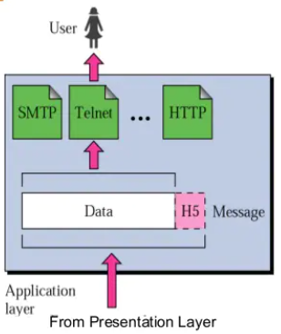
Application Layer
It interacts with application programs and is highest level of OSI Model. It contains management functions to support distributed applications.

Slide 34
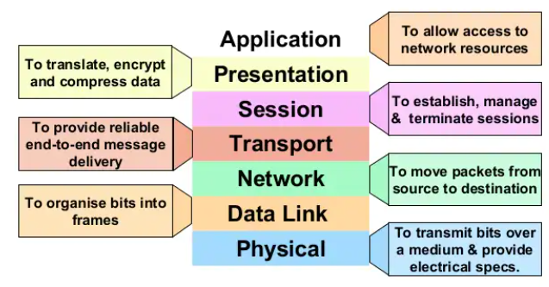
Summary of Function of Layers
(Identification, authentication)
(Format conversion)
(Set-up coordinate conversation)
(Ensures error-free transfer)
(Routing of data through network)
(Error control and synchronization)
(Placing signals on the carrier)

Slide 35
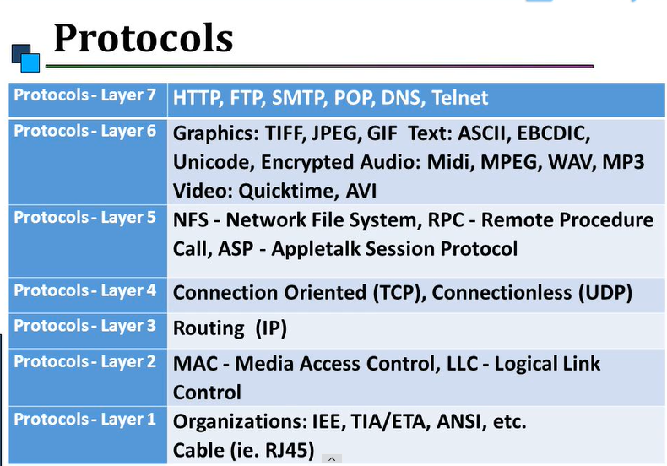

Slide 36

Service Performed at Each Layer
E-mail, Web browser, Directory
POP, SMTP, FTP, HTTP, DNS
Sockets
TCP
IP
PPP, Ethernet, Token ring
100baseT
Notes:
I will not send data anymore until i get an acknowledgment.
this process is slow
It is used for security purpose
example: web, sending mail, receiving mail etc
UDP
Here i have no headache with acknowledgment.
this process is faster but here data can be lost .
example : video streaming , online games etc
TCP + UDP = SMTP(example : mobile,telephone)

Slide 37


Slide 38
Transmitting and Receiving in Comm. Systems

Slide 39

Serial Transmission
Data is transmitted, on a single channel, one bit at a time one after another
Much faster than parallel because of way bits processed (e.g. USB and SATA drives)

Slide 40

Parallel Transmission
Each bit has it’s own piece of wire along which it travels
Often used to send data to a printer

Slide 41
Why not to use Parallel instead Serial?
Due to inconsistencies on channels data arrives at different times
Because of the way it is transmitted packet switching cannot be used
The above two points makes parallel slower than serial and requires higher bandwidth.
Parallel transmissions are rarely used anymore

Slide 42
Synchronous VS Asynchronous Transmission
Synchronous Transmission
All data sent at once and no packet switching
Asynchronous Transmission
Uses stop/ start bits
most common type of serial data transfer
Allows packet switching
Allows sharing of bandwidth (i.e. talk on phone while another person is using internet)

Slide 43


Transmission Directions
Simplex:
One direction only

Slide 44


Half duplex:
Both directions but only one direction at a time

Slide 45


Full duplex:
Send and receive both directions at once.

Slide 46
Network Topologies
Mesh Topology
Ring Topology
Bus Topology
Star Topology

Slide 47

Mesh Topology

Slide 48

Ring Topology

Slide 49

Bus Topology

Slide 50

Star Topology

Slide 51
Network Hardware

Slide 52

Bridge
Large networks can be separated into two or more smaller networks using a bridge. This is done to increase speed and efficiency. This type of network is called a segmented LAN and has largely been superseded by the use of switches which can transfer data straight to a computer and thus avoid bottleneck jams which bridges were designed to fix.

Slide 53

Gateway
Often used to connect a LAN with a WAN.
Gateways join two or More different networks together.

Slide 54
Some more
Routers: A router is a networking device that forwards data packets between computer networks. Can be used in place of a switch or bridge.
Switches: smart hubs which transmit packets to the destination port only
Hubs: like double adapters /power boards in the home except instead of plugging in extension cords we are plugging in computers to allow them to communicate.

Slide 55



Transmission Media
Twisted pair – Ethernet cable
Coaxial cable –Thick black cable used for higher bandwidth communications than twisted pair (i.e. Optus cable)
Fiber optic – data transferred through pulses of light. Extremely fast.
Non cable methods such as satellite, microwave, wireless and Bluetooth

Slide 56
End of the Lecture

